Slide 1
Responding to Problem Behaviors: Socially Mediated vs. Emotionally Driven
Diana Browning Wright, M.S., L.E.P.

Slide 2
The ACEs Study Implications
Adverse Childhood Experiences (ACE) Study
  Calculate yourself (but keep it private)
  Calculate 2 different students with behavior issues for whom you know their background very well
  HERE WE GO!

Slide 3



What Are ACEs?
Adverse Childhood Experiences
ACEs are experiences in childhood that are unhappy, unpleasant, hurtful.
Sometimes referred to as toxic stress or childhood trauma.
Notes:
3

Slide 4
Adverse Childhood Experiences Survey
Let’s Review the Implications

Slide 5





An ACE Score of 4 or more results in having multiple risk factors for these diseases or the disease themselves
An ACE score of 6 or more results in a 20 year decrease in life expectancy
Notes:
5

Slide 6
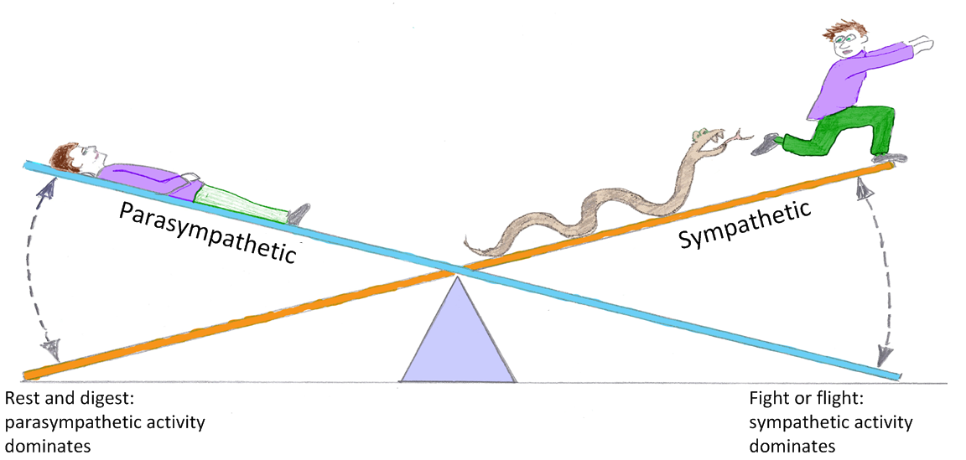
Stress – Wigs Kids Out (and us too)
Homeostatic balance (a state of homeostasis): having an ideal body temperature, an ideal level of glucose in the bloodstream, an ideal everything
Stressor: anything that knocks you out of homeostatic balance
Notes:
So, what the heck is stress? If you recall from 9th grade science class, homeostasis represents balance or equilibrium. It basically refers to an ideal body temperature, an ideal level of glucose in the bloodstream, an ideal amount of saliva in the mouth, an ideal everything. When we get knocked out of homeostasis, this is what we call stress. Stress is anything that knocks you out of homeostatic balance.
If you are a normal mammal, a stressor is a challenge to homeostatic balance--a real physical challenge in the world--and the stress response is your body’s effort to re-establish homeostasis. For example, if you are a zebra on the Serengeti plains and a lion comes chasing after you for lunch, you would be knocked out of homeostatic balance and the body would trigger the stress response to get you out of there. If you managed to escape, you wouldn’t stay at a heightened level of alertness for a prolonged period of time. You would eventually return back to homeostatic balance. We will learn shortly that homeostasis is a dynamic balance between the autonomic branches of the nervous system.
Clay, this narration will also need a brief discussion of the autonomic branches (or a statement that you’ll explain them in later slides), and an explanation of the diagram. Also—is the diagram your own, or will we need to get permission?

Slide 7
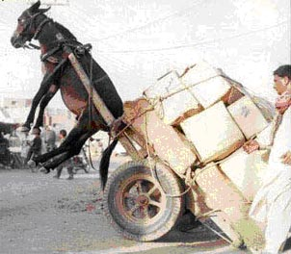
Allostatic Load
When Stress Becomes Too Much
Allostatic load: the wear and tear on the mind and body that results from either too much stress or inability to manage stress.
  Not turning off the stress response when it is no longer needed
  Response to perceived stressors that never even happen
  Inability to manage the intensity of stressors in the moment
Notes:
Allostatic load is a fancy way of saying that stress accumulates in the body. When stress accumulates it can become toxic to a person’s mental and physical well-being. If you recall from an earlier slide the term homeostatic balance, allostasis refers to the active process by which the body responds to daily events and attempts to maintain homeostatic balance. Allostasis literally means “achieving stability through change”. It is a measure of healthy adaptability. Allostatic load refers to how much your body is working to keep your mind and body in order. The more stress, the harder the mind and body are working. When allostatic load is high, there tends to be wear and tear on the mind and body. When there is wear and tear on the mind and body, people experience a range of potential problems.
The aim, then, is to develop skills and routines that enable us to keep allostatic load at a reasonable level so that there is minimal wear and tear on our minds and bodies. This course is devoted to helping us do just that.
Clay, it’s not quite clear to me if the bullet points on the slide are the results or the causes of allostatic load. Could you help me clarify that, please?
Also--the sentence about perceived stressors--I wonder if that topic needs its own slide--definitely needs a bit more explanation, though.

Slide 8
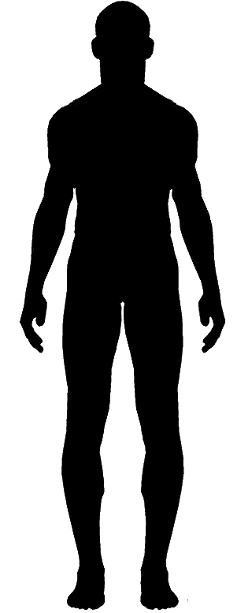

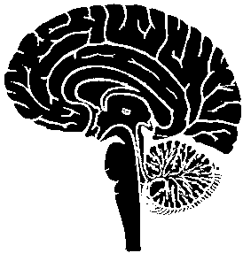
Negative Impact of High Allostatic Load
On our body:
Headache
Muscle tension or pain
Cardiovascular
Fatigue
Change in sex drive
Stomach upset
Sleep problems
On our mind:
Anxiety
Restlessness
Lack of motivation
Memory problems
Irritability & anger
Sadness or depression
On our behavior:
Angry outbursts
Avoidance of important activities
Overeating or undereating
Social withdrawal
Drug or alcohol abuse
Notes:
When allostatic load is high, our bodies, minds, and behaviors can be negatively affected. Experience stress regularly enough and you’re going to damage your cardiovascular system. Increased blood flow hammers on the lining of your blood vessels, which causes irritation and inflammation. Fat and other junk clings to arterial walls and can cause clogging, which happens to be bad news for your heart. You are more at risk for chronic fatigue, sleep problems, muscle loss, and most significantly, adult-onset diabetes. This once rare disease is now on the verge of becoming the number one cause of death in the US.
High amounts of stress stress also causes impairments to the nervous system. Stress damages neurons in the part of the brain called the hippocampus and weakens the connections between neurons, so they don’t communicate well with one another. The hippocampus is a part of the brain that is responsible for forming, organizing, and storing memories. Therefore stress can interfere with the ability to form and retrieve important memories.
The opposite thing happens in the amygdala, which is the epicenter in the brain for fear. Whereas stress damages the hippocampus, it feeds the amygdala. The amygdala actually grows and gets bigger. Chronic stress creates a super sensitive amygdala, and this is why stress is related to so many anxiety disorders. Dopamine levels are also affected. Dopamine is a neurotransmitter that is about reward and pleasure. Cocaine, sex, and cheeseburgers work on the dopamine system. Chronic stress drains the brain of dopamine, which diminishes your ability to feel pleasure. So if stress depletes your dopamine, then there is an increased likelihood for experiencing depressive symptoms.
Stress also impacts the frontal cortex. The frontal cortex is the most human part of the brain, as ours is relatively larger than any other species. The frontal cortex is responsible for delaying gratification, being self-disciplined, long-term planning, weighing consequences of one’s actions, and emotional regulation. It’s the last part of the brain to fully mature. This doesn’t happen until you’re 25 years old—some how the car rental companies knew about neural development.
What does chronic stress do to the frontal cortex? It creates a loss of neurons and disconnecting circuits. As a result, you make bone head and regretable decisions, which may haunt you--and yet you thought they were brilliant or seemed reasonable at the time. That’s another effect of chronic stress: Your judgment tanks and goes down the tubes.
Clay, could you say just a bit about the function of the hippocampus and of the neurons? I don’t think we can count on our students knowing those things.
Could you find an example of brain immaturity that isn’t related to a standard college experience? I’m not sure that all our students had a traditional freshman year---they may have stretched it out over several years, worked fulltime, etc., and it may have been quite a while ago.

Slide 9
Adverse Childhood Experiences (ACES) Study
Of 17,000 respondents, two-thirds had at leat one adverse childhood event
Physical, emotional or sexual abuse
Emotional or physical neglect
Growing up with family members with mental illness, alcoholism or drug problems
Family violence
Incarcerated family member
One or no parents
Parental divorce

Slide 10
Findings
Of the 17,000+ respondents…
Two-thirds had at-least 1 adverse childhood event
1 in 6 people had four or more ACES
More than 25% grew up in a household with an alcoholic or drug user
25% had been beaten as children

Slide 11
Findings Continued
People with ACE scores of 4 or more:
  Twice as likely to smoke
  Seven times as likely to be alcoholics
  Six times as likely to have had sex before age 15
  Twice as likely to have cancer or heart disease
  Twelve times more likely to have attempted suicide
  Men with six or more ACEs were 46 times more likely to have injected drugs than men with no history of adverse childhood experiences

Slide 12
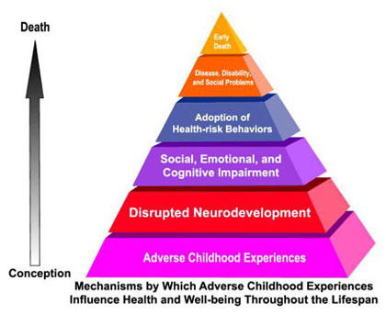

Notes:
12

Slide 13
Three-Tiered RtI Model for Behavior and Social/Emotional Support
Select an approach based on whether behavior is socially mediated vs emotionally driven:
Cognitive Behavior Therapy/Counseling (CBT)
FBA based BIP with replacement behavior training
Wrap Around and other parent focused assistance
Inter-agency services
Tier 3
(High-risk Students)
Individual Interventions
(Likely to be sufficient for 3-5% of students)
Progress Monitoring
Select a behavior intervention matched to student characteristics:
Self-monitoring
Structured adult mentor program
(e.g., check in, check out)
Daily home/school notes
Behavior contracts
Small group social skills or SEL training
Escape Card
Positive Peer Reporting
Tier 2
(At-risk Students)
Intensified classroom and small group interventions
(Likely to be sufficient for 7-10% of students)
UNIVERSAL SCREENING
Positive Behavioral Supports (www.pbis.org)
16 proven proactive classroom management strategies
Social Emotional Learning (SEL) Curriculum (www.casel.org)
KFFC: Kind, Firm, Fair, Consistent teaching
Positive relationships with all students
Physiology for learning instruction
(diet, sleep, exercise, stress management)
Tier 1
(All Students)
Culturally responsive environments,
classroom strategies with accommodation planning
(Likely to be sufficient for 85-90% of students)
Graphic by Diana Browning Wright

Slide 14
Why not stop light?
Card Pulling vs. Rainbow Club
See handout “Classwide systems”
On www.pent.ca.gov for Rainbow Club

Slide 15
Compare and Contrast
Rainbow Club | Card Pulling Stop Light
A class wide system focused on drawing attention to rule following behavior | A class wide system featuring drawing class attention to rule breaking
Maintains and Enhances Teacher/Student(s) relationships | Disrupts teacher/student(s) relationships
Consistent with behavioral theory: progressive shaping (reinforcing) of behavior with built in response cost that allows correction without rejection; basic human needs: enhances a sense of belonging | Inconsistent with behavior theory: It focuses on finding students to publically show “they aren’t like you;” emphasizes punishment as the overarching control method, can disrupt sense of belonging

Slide 16
Compare and Contrast
Rainbow Club | Card Pulling Stop Light
Allows for private response cost: lowering to the color below the current achievement of the student in a private manner, then “catch ‘em being good” to restore as soon as possible | Often the restoration is not immediate and has side effects on class climate in that some children fear the teacher may “pull their card” and humiliate them randomly
All students begin at the bottom every several days; no student stays at lowest level for more than an hour | All students are at top level (green) and the only place to go is down rather than motivating all students to go up
Allows teacher to walk around with “cues” (colored cards) to award the next layer in the rainbow Payoff daily is by achievement earned; all students earn something | Allows teacher to walk around looking for violations No payoff for achievement

Slide 17
Moving To Behavior Intervention Plan (BIP) Or Other Tier 3?
Socially mediated vs. emotionally driven?
Socially Mediated, i.e., externally reinforced, behavior is to get something or to reject/escape something in an environment
Emotionally Driven, i.e., internally reinforced, or a response to previous trauma triggered now in this environment

Slide 18
BIP Examples Of Behaviors
Examples of socially mediated behaviors that may not have not responded to default behavior interventions and therefore require a BIP include:
Hitting others in protest/escape their behaviors, or hitting to get their attention
Making sexually explicit remarks to get laughs from others
Refusing to do work to escape the task requirement, or the class!
Etc., etc.

Slide 19
Socially Mediated Behaviors In BIPs Require:
Replacement behavior training
  Socially mediated behaviors require instruction on skillful use of a functionally equivalent replacement behavior (FERB) when default interventions failed
Reinforcement of overall positive behaviors as well as FERBs
Specification of how staff should respond if and when problem behavior occurs again
Progress Monitoring and Two-Way Communication

Slide 20
Cognitive Behavior Therapy (CBT) And Other Evidence Based Therapy/ Counseling
Anxiety triggered by fear of failure or separation anxiety or selective mutism that is not seeking a response from the environment and does not respond to environmental changes and default behavior interventions. These require a specific protocol to address the emotions, e.g., a cognitive behavioral treatment plan.
Depressed withdrawn behaviors not seeking a response from the environment that have not responded to lesser interventions that have attempted to “behaviorally activate” require a cognitive behavioral treatment plan.

Slide 21
Emotionally Driven Examples
School Phobia and other phobias that require a specific evidence based protocol to systematically desensitize the student to stress provoking stimuli. (CBT approaches)
Habits, such as tic disorders, that require an evidence based Habit Reversal Protocol (CBT approaches)
Repetitive genital rubbing (pleasure seeking) that has not responded to environmental changes to enhance engagement and is not associated with child abuse (non FERB based Direct Treatment protocol)

Slide 22
Emotionally Driven Examples
Separation Anxiety, Selective Mutism, etc
Post-Traumatic Stress Disorder (PTSD)
Other Trauma Disorders
Evidence Based Treatment Required!
See: www.pent.ca.gov/forms for a Direct Treatment Protocol

Slide 23
Reminder: Quality BIPs
All effective plans are a movie, not a snapshot
Change environment variables
Teach alternative, acceptable (replacement) behaviors- FERB and General Positive Behavior Skills
Reinforce general positive behavior AND use of Functionally Equivalent Replacement Behavior
Safely and productively handle problem behavior when/if it occurs again
Two-way Communicate with key stakeholders
Includes a Progress Monitoring Schedule
Notes:
The new behavior still has to meet the old behavior’s need.
e.g., if throwing the spelling paper off the desk was a protest, replacing the page with a shorter page doesn’t satisfy the need to protest. You can decrease the need to protest but must offer an acceptable manner to protest.
l

Slide 24
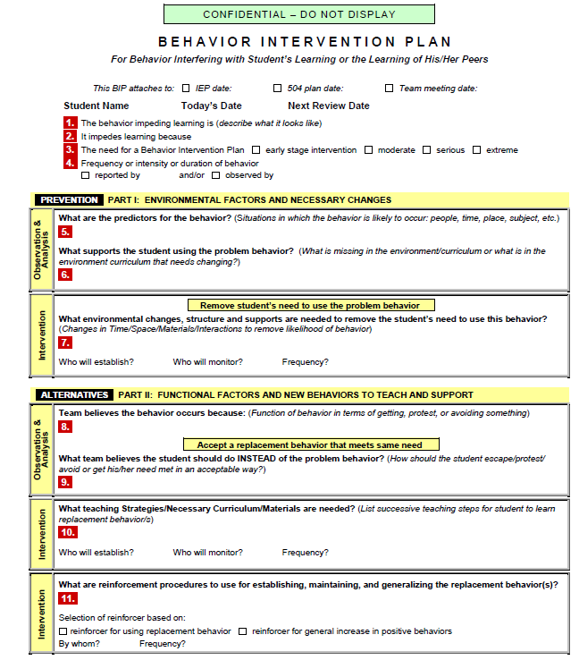
© Diana Browning Wright, Initiatives and Training

Slide 25
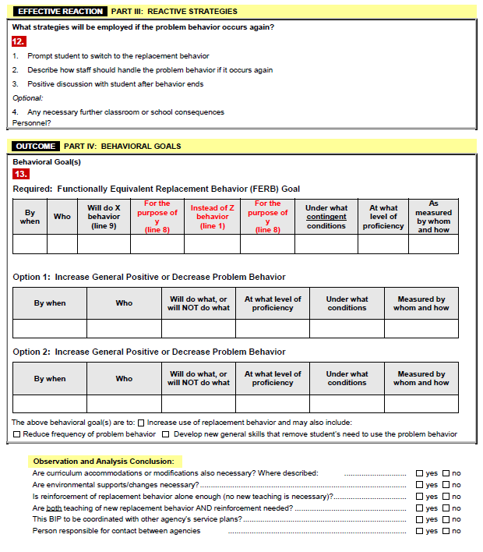
© Diana Browning Wright, Initiatives and Training

Slide 26
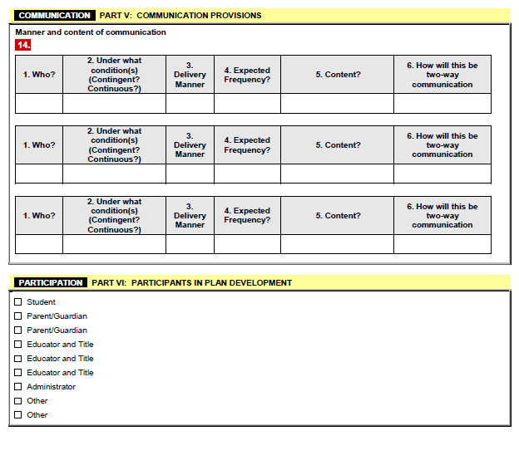
© Diana Browning Wright, Initiatives and Training

Slide 27
Evaluating Your Functional Behavior Assessment (FBA) Report
Were all elements that document process and conclusions included?
Did you specify that a BIP is appropriate for the problem?
See: Checklist for Complete FBA Reports and a model FBA report at www.pent.ca.gov/forms

Slide 28
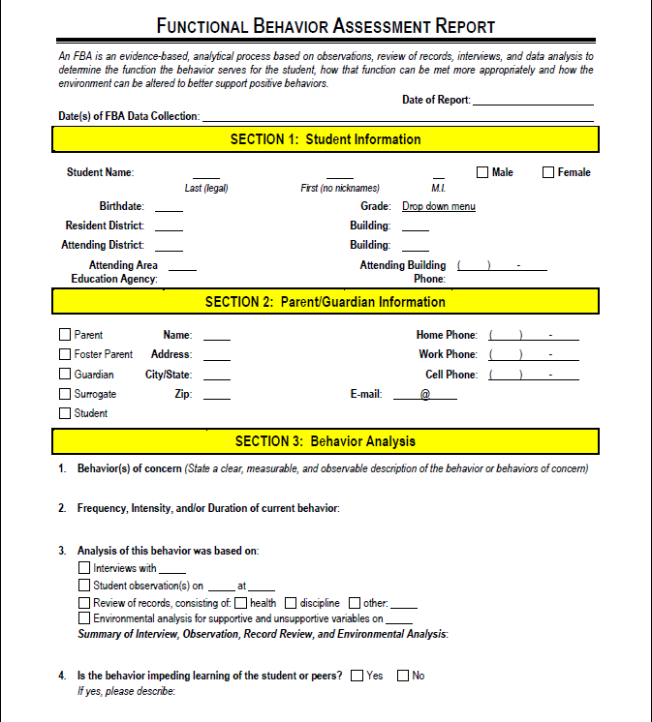
FBA Report
© Diana Browning Wright, Initiatives and Training

Slide 29
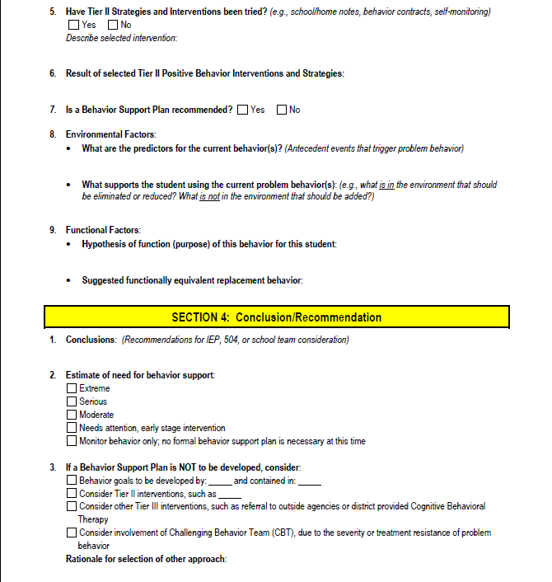
© Diana Browning Wright, Initiatives and Training

Slide 30
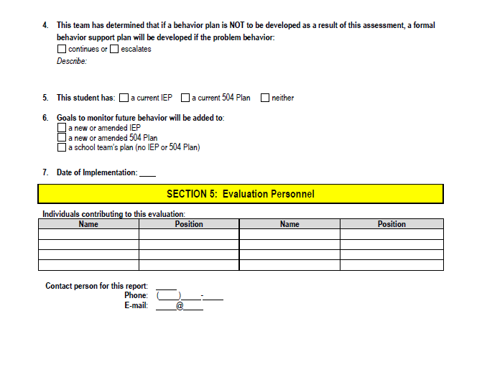
© Diana Browning Wright, Initiatives and Training

Slide 31
BIP Desk Reference And BIP-QE II
Use to train staff on the key concepts of applied behavioral analysis and behavior intervention plans
Download the 345 page manual for free: www.pent.ca.gov

Slide 32
Multiple Purposes For BIP-QE II
Use to keep proper focus balance between positive behavioral interventions and potential future disciplinary considerations
Use when a BIP has not been successful
Use to improve your ability to legally defend the team’s Behavior Plan

Slide 33
What The BIP-QE II Does NOT Measure
Whether the new behaviors, interventions, environmental changes, and reinforcers fit the student
Whether the behavior was socially mediated or internally driven
Whether this plan is developmentally
appropriate for this student
See: http://www.pent.ca.gov/beh/dev/dev.html
Notes:
Asking Mikey to eat in the cafeteria

Slide 34
BIP-QE II Does NOT Measure Fidelity
Whether the plan was or will be implemented consistently and skillfully
This takes observation, data analysis and review systems

Slide 35
Peer Reviewed Journal Publications
www.pent.ca.gov/hom/research.html
Cook, C.R., Mayer, G.R., Browning-Wright, D., Kraemer, B., Gale, B. & Wallace, M.D. (2012). Exploring the link between evidence-based quality of behavior intervention plans, treatment integrity and student outcomes under natural educational conditions. The Journal of Special Education, 46, 3-16.
Kraemer, B. R., Cook, C. R., Browning-Wright, D., Mayer, G. R., & Wallace, M. D. (2008). Effects of training on the use of the Behavior Support Plan Quality Evaluation Guide with autism educators: A preliminary investigation examining positive behavior support plans. Journal of Positive Behavior Interventions, 179-189.

Slide 36
Peer Reviewed Journal Publications
www.pent.ca.gov/hom/research.html
Cook, C. R., Crews, D., Browning-Wright, D., Mayer, R., Gale, B., & Kraemer, B. (2007). Establishing and evaluating the substantive adequacy of positive behavior support plans. Journal of Behavioral Education, 16, 191-206.
Browning-Wright, D., Mayer, G. R., Cook, C. R., Crews, D., Kraemer, B. R., & Gale, B. (2007) A preliminary study on the effects of training using behavior support plan quality evaluation guide (BSP-QE) to improve positive behavioral support plans. Education and Treatment of Children, 30, 89-106.

Slide 37
Implications Of Research
For Practitioners
Research on the BIP has demonstrated that the better the evaluated plan, the more likely the plan will be implemented with fidelity
  “Failure to properly or consistently implement the behavioral interventions identified in an appropriately developed BIP can amount to a denial of FAPE.” (Norlin, John W. (2012) FBAs and BIPS: Meeting IDEA Compliance Obligation. Palm Beach Gardens, Florida: LRP publication, p.28.]

Slide 38
Implications Of Research
For Practitioners
The BIP-QE II is a valid and reliable instrument for evaluating behavior plans
Use the BIP-QE II as a training tool when teaching staff how to develop a complete and adequate BIP. Research has shown that this tool increased staff performance
Periodically evaluate your plans to maintain skill mastery

Slide 39
What IS The Positive Behavior Intervention Process for Socially Mediated Behaviors?
A data-driven team approach with built-in accountability for a supplementary aid & support
  Follows a carefully look at the context of the problem behavior
  Hypothesizes why the behavior is occurring
  Develops a plan to teach the student a replacement behavior and new skills
  Changes environments to match student needs
  Involves people who really care about the student
  Develops a written plan capturing the team’s decisions and methods
Notes:
“Positive Behavior Support” is a conceptual approach that is rapidly changing how we approach problem behavior. By focusing on the following approaches and key concepts, even behaviors that have been occurring for a long time can be changed. These concepts are radically different from reduction approaches that simply try to either punish the student for the behavior, or reward the student if s/he stops the problem behavior.

Slide 40
What IS The Positive Behavior Intervention Process for Emotionally Driven Behaviors?
A data-driven team approach with built-in accountability for related services to benefit from Special Education
  Follows a carefully look at the context of the problem behavior and the history of trauma and triggers
  Hypothesizes why the behavior is occurring
  Develops a plan to teach the student coping behaviors and new skills
  Involves people who really care about the student
  Develops a plan capturing the team’s decisions and methods
Notes:
“Positive Behavior Support” is a conceptual approach that is rapidly changing how we approach problem behavior. By focusing on the following approaches and key concepts, even behaviors that have been occurring for a long time can be changed. These concepts are radically different from reduction approaches that simply try to either punish the student for the behavior, or reward the student if s/he stops the problem behavior.

Slide 44
Streamlined 10 Steps
After the decision is made to conduct the assessment and permission is received
Meet with teacher(s) and outline the follow-up steps to plan development
  Typically 30 minutes
Review Records and Interview Stakeholders (e.g., teachers, parents, administrators, paraeducators, therapists peers, etc.)
  Typically 1-2 hours
Classroom observation (see section 3 in BIP Manual on line) for environmental assessment and functional observation
Typically 30 minutes to one hour

Slide 45
Streamlined 10 Steps
Set up data collection for baseline and explain to classroom staff (use FAOB, see section 3 on line)
  Typically 30 minutes
Collect and Analyze data
  Typically one hour
Meet with implementer(s) and discuss the 3 pathways on the pathway chart, using “consultant script for pathways”(see section 3)
  Typically 45 minutes to one hour
Write FBA or Social/Emotional/Mental Health report or other summary of data collected
  Typically 30 to 45 minutes

Slide 46
Streamlined 10 Steps
Transfer report data to appropriate places on a behavior plan or a direct treatment plan and prepare notes for IEP or other meeting
  Typically 30 to 45 minutes
Meet as a IEP or school team. Get three agreements again from all elements of pathway chart with all members and discuss the FBA findings
  Typically 30 minutes
Develop interventions as a team to match analysis, with parent giving “meaningful input and participation” OR describe treatment approach for emotionally driven behavior
  Typically one hour

Slide 47
Remove Need By Teaching Alternative Skills (Socially Mediated)
Replacement Skills: One-to-one replacement skills that serve the exact function as the problem behavior
General Skills: Broad skills that alter problem situations and prevent the need for problem behaviors
Coping and Tolerance: Skills that teach students to cope with or tolerate difficult situations

Slide 48
Problem Behavior Decreases When These Skills Are In The Repertoire Of The Student (Socially Mediated)
Get/Obtain: Attention, Activity, Objects
Express choice or preferences
Follow schedule & participate in routines
Request help
Initiate interaction or gain attention
Self-manage within activities
Work toward delay of reinforcement

Slide 49
Problem Behavior Decreases When These Skills Are In The Repertoire Of The Student (Socially Mediated)
Avoid/Escape: Activity, Attention, Demands
Use schedule or checklist to self-manage
Set own work goals
Express preferences or choice
Request and take break
Participate in steps or portion of routine
Request or seek help

Slide 50
Communication Skills Prevent Problem Behaviors (Socially Mediated)
TEACH – How to ask for or signal for:
help a break
interaction attention
time alone reduced demands
more time alternative assignment
choice opportunity to move around

Slide 51
Problem Behavior Decreases When General Skills Increase (Socially Mediated)
Academic Skills
Use of Technology – Hi & Lo Tech
Organization Skills
Leisure Skills
Social Interaction Skills
  Initiate and respond to interactions
  Make friends
  Problem solve
  Deal with stress

Slide 52
Problem Behavior Decreases When Self-Management Or Coping Skills Increase (Socially Mediated and Emotionally Driven)
TEACH Relaxation Techniques
Positive Self – Talk
Guided Imagery
Deep Breathing
Muscle Relaxation
Physical Stress Relievers
Mindfulness (See Mind Up)

Slide 53
2. Desired
Alternative
3. Typical
Consequence
Summary Statement
Talk about social topics
Reciprocal conversations
6. Setting Events
4. Triggering
Antecedents
1. Problem
Behavior
5. Function
No conversation for 15 minutes
Presence of peers in free time
Says toileting or sexual words, (e.g., F…, S…, P..)
Initiate and sustain a social interaction
7. FERB
Johnny
“Let’s Talk!”
Graphic by Diana Browning Wright
Notes:
53

Slide 54
2. Desired
Alternative
3. Typical
Consequence
Summary Statement
Sit down and prepare for instruction
Ready for instruction
6. Setting Events
4. Triggering
Antecedents
1. Problem
Behavior
5. Function
Hot Day
Bumped by Peer
“What do I have to do to get you to leave me alone?
Kill YOU
Protests/ Rejects removes physical contact
7. FERB
NATHAN
“Don’t touch, I need personal space!”
Graphic by Diana Browning Wright
Notes:
54

Slide 55
Socially Mediated Behavior Problems
Type 1: One problem behavior for one function
  Hits to engage others
Type 2: Two or more problem behaviors for one function
  Hits, spits, bites to avoid doing work
Type 3: One behavior for two or more functions
  Hits to engage others and to escape work

Slide 56
Behavior Problems
Type 4: Multiple behaviors in sequence for one function
  Rocks, mutters, throws chairs, then runs to escape work
Type 5: Multiple discrete behaviors for multiple functions
  To engage others, student hits
  To escape, student runs away
  To get attention from teacher, student spits on desk
  To get to front of line, knocks over peers

Slide 57
Behavior Problems
Requires one pathway for each behavior unless Type 4, which can list problems in sequence in the problem behavior box
Do NOT write a Behavior Plan for more than 2 or 3 multiple behaviors with different functions
  Choose pivotal behaviors and write behavior plan for one or two behaviors
  Often environmental changes will alter multiple behaviors

Slide 58
Research On Training And Scoring Behavior Plans
A method of learning behavior analysis and improving quality of plans
A method of evaluation of the extent to which your plan is in alignment with the field of behavior analysis
A method of improving likely fidelity once the plan is approved
A method of improving outcomes for students

Slide 59
Most Recent Published Research
Exploring the connection between Positive Behavior Support (PBS) plan quality, plan implementation fidelity, and student outcomes
PBS Plan Quality
Student Outcomes
PBS Plan Implementation Fidelity
Graphic by Diana Browning Wright

Slide 60
Relationship Between
Plan Quality And Plan Fidelity
Results: the better the plan, the more likely the plan is to be implemented with integrity (i.e., implemented as written [r = .56])
Analysis results: We examined the sequence to determine whether fidelity significantly predicts student outcomes
  Step 1: Developed a high quality plan
  Step 2: Implemented the plan with high fidelity (as written)
  Step 3: Improved student outcomes

Slide 61
Follow-up Analysis Needed
Research Needs: Staff characteristics that relate to behavior plan quality, implementation fidelity, and student outcomes
  Preliminary results suggest that “number of ABA courses” is positively correlated with PBS plan quality (the more courses, the better the plan) and
  “Years in education” is negatively correlated with BIP quality (i.e., the more years in education the poorer the BIP plan)

Slide 62
Where To Get Free
Self-Training On-line
www.pent.ca.gov
“Behavior Intervention Plan Desk Reference”
  A Comprehensive Manual that includes how to score behavior plans (section 15) write effective behavior goals (section 8) that are measureable, how to develop effective communication between all stakeholders, how to link pathways to the plan (section 3), how to consult using the pathway tool (section 3) and many other embedded “how to” guides

Slide 63
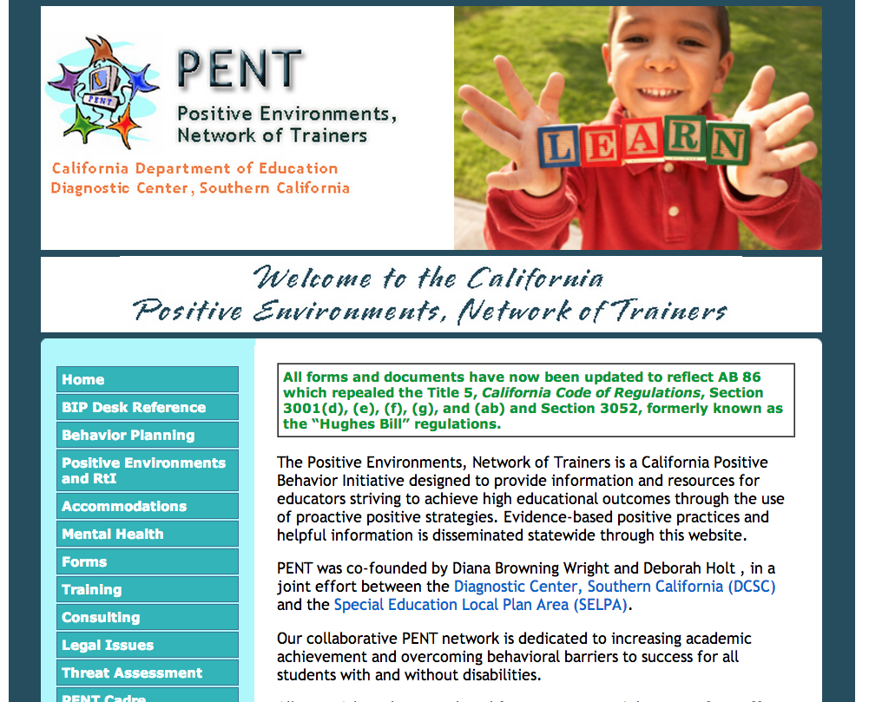
www.pent.ca.gov

Slide 64
Emotionally Driven Behaviors?
Related Service to Benefit from Special Education vs.
Supplementary Aids and Services to Maintain the LRE

Slide 65
Earlier Onset Of Internalizing Disorders
First episode of anxiety, depression is occurring earlier and earlier in American culture
Warnings on increasing internalizing disorders in children are increasing
Cultural shift from “the American Dream” to “Bleak Outlook” see: Optimistic Child by Martin Seligman

Slide 66
School-Based Problems And Disorders
Internalizing problems:
  Anxiety, Fears, Phobias
  Depression
  Trauma Responses
Children and youth vary from normal to disordered functioning in each of these areas

Slide 67
Anxiety Disorders
Prevalence of Anxiety, Fears, Phobias
  6-15% for children and adolescents
    2.0-12.9% Separation anxiety (normal between 7 mo. And 6 years)
    5.0-10.0% Generalized Anxiety Disorders (GAD)
    3.0-10.0% Specific phobia
    0.5-2.8% Social phobia
    1.0-2.0% Obsessive Compulsive Disorders (OCD)

Slide 68
Depressive Disorders
Prevalence of Major Depression:
  3% in preadolescents
  15-20% in adolescents
  Girls > Boys in adolescence
Prevalence of Dysthymic Disorder:
  ~3% of children and adolescents
  Equal in males & females during childhood/adolescence

Slide 69
Trauma-Related Emotional Disorders
Prevalence of Post-Traumatic Stress Disorder (PTSD)
  2-5% of children and adolescents
  Fewer than 20% of children with a history of exposure to a traumatic event have had a psychiatric disorder, mainly anxiety disorders, including post-traumatic stress disorder (PTSD)
  (Costello, Erkanli, Fairbank, & Angold, in press)
Sex differences
  Girls 2-3 times more likely than boys

Slide 70
What Is Trauma?
Sudden or unexpected events
Shocking nature of events
Actual or threatened death/threat to life/bodily integrity
Subjective feelings of intense terror, horror, or helplessness

Slide 71
Which Experiences Are Traumatic?
Child physical or sexual abuse
Witnessing or victimization of domestic, community, or school violence
Severe accidents
Potentially life-threatening illnesses
Natural/human-made disasters
Sudden death of family member/peer
Exposure to war, terrorism, or refugee conditions

Slide 72
Maltreatment Data
U.S. Department of Health & Human Services, Administration on Children Youth & Families. Child Maltreatment
  Data on severe inflicted child abuse, trauma, which in 2011 resulted nationally in the death of 1570 per 100,000 children
    76.7 million children 0-17 in USA projected for 2013, data not yet available
    http://www.acf.hhs.gov/sites/default/files/cb/cm11.pdf#page=28

Slide 73
What Teachers And Staff Observe In Emotional/Internalizing Patterns Of Behavior
A shrinking of the student’s repertoire of approach behaviors and skills to nothing (poor use of social skills)
Students develop a repertoire of avoidance behaviors in attempt to alleviate anxiety out of their life.
Students that fear separation from their caregivers attempt to cling to their caregivers to avoid being separated.

Slide 74
What Teachers See And Hear As Student Reacts To Provocative Stimuli
Physical sensations: (e.g., rapid heart rate, short of breath, cold sweaty hands, blushed face, butterflies)
Thoughts/Beliefs: faulty interpretation and meaning making of situation
Escape/Avoidance Behaviors: attempt to remove contact with provocative stimulus
Oppositional Behaviors: when forced to have contact with provocative stimulus
Feelings: sad, angry, upset, depressed, worried

Slide 75
What Teachers See And Students Report
Somatic complaints: headaches, stomachaches, muscle tension
Physiological arousal: racing heart, sweating palms, teeth chattering, dizziness, flushed face, trembling hands

Slide 76
Early Intervention By Teachers
Through Physiology For Learning
Use Strategies and Procedures to Monitor and Support Physiology for Learning
  Diet: teach and support families in healthy eating/healthy minds
  Sleep hygiene: log activities 30 minutes before bedtime activities, time in bed , times up in the night, time out of bed, fatigue level at waking and daily mood

Slide 77
Early Intervention By Teachers
Through Physiology For Learning
Use Strategies and Procedures to Monitor and Support Physiology for Learning
  Exercise: endorphins – move it or lose it
  Stress management e.g., relaxation techniques, “belly breathing,” mindfulness practices, etc.
  Stress Management: Evidence based mindfulness-see www.learning2breathe.org (HS) and www.mindup.org (pre k-8)

Slide 78
Early Intervention By Teachers Prevention Through Mindfulness Training
Existing in the present moment
  Preventing the thoughts about the past and future from invading and capturing your mind
What’s happening now?
  Going through the senses
    What am I seeing?
    What am I smelling?
    What am I feeling?
    What am I hearing?
    What am I tasting?
    See: http://mindfulnessforchildren.org/research/

Slide 79
Resources for Schools
Mind Up:
http://thehawnfoundation.org/mindup/mindup-curriculum/
Mindfulness In Education:
www.mindfuleducation.org
Mindful Schools:
http://www.mindfulschools.org
Positive Psychology:
www.greatergood.berkeley.edu www.ggia.berkeley.edu
www.authentichappiness.org

Slide 80
Positive Psychology: Evidence-Based Resources
https://sites.google.com/site/psychospiritualtools/Home/psychological-practices/three-good-things (Listen to Martin Seligman explain the 3 good things technique)
Ben’s Top 11 positive psychology websites at: http://www.authentichappiness.sas.upenn.edu/newsletter.aspx?id=76
http://www.authentichappiness.sas.upenn.edu/books.aspx (Look for THE OPTIMISTIC CHILD)
http://www.authentichappiness.sas.upenn.edu/testcenter.aspx (Look for adult and children tools)

Slide 81
Depression Specific Strategies
Tracking of Mood/Activity Level
Behavioral Activation Planning
  Identify baseline level of pleasant events
  Identify “high impact” activities
  Promote participation in pleasant activities
    Join a club (to increase social experiences)
    Set a goal to learn to do something better (to increase success experiences)
    Invite others to join your activities
  Reward completion of goal doing something that is:
    Very enjoyable
    Under self-control
    Powerful – equal to effort made to accomplish goal
    Immediately available

Slide 82
Social Emotional Learning (SEL)
These Social Emotional skills include the ability to:
  Recognize and manage emotions
  Care about and respect others
  Develop positive relationships
  Make good decisions
  Behave responsibly and ethically
© 2006. Collaborative for Academic, Social, and Emotional Learning (CASEL).

Slide 83
Two Components To SEL
SEL involves:
  Teaching students a set of skills to help support their social and emotional well-being and,
  Creating a safe, caring learning environment conducive to learning where students are encouraged and reinforced for applying those skills.

Slide 84
What Works?
Internalizing
Externalizing
PBS alone, no change
SEL alone, moderate change
SEL combined with PBS substantive change
SEL alone, small change
PBS alone, moderate change
SEL combined with PBS substantive change
Cook, C.R., Frye, M., Jewell, K., & Slemrod, (under review). Preliminary evaluation of combining Positive Behavior Support and Social Emotional Learning as an integrated approach to school-based universal prevention. School Psychology Review.

Slide 85
Signs Of Need For Second Tier Of Supports And Recommendations
In Behavioral RTI/MTSS schools: High scores on the internalizing half of Universal Screening Measures for behavior
In non-RTI/MTSS schools: high intensity, duration and/or frequency of presenting problems described above, after prevention measures have been used both in class and school-wide

Slide 86
Tier III Menu of Individual Supports for a FEW:
FBA-based Behavior Intervention Plan
  With Replacement Behavior Training
Cognitive Behavior Therapy
Home and Community Supports
Interagency coordination
IN AN IDEAL WORLD:
Menu of a continuum of evidence-based supports
combining behavioral
And emotional
Targeted/
Intensive
(High-risk students)
Individual Interventions
(3-5%)
Intensity of Assessment and Supports
Tier II Menu of Default Supports for SOME:
  Behavioral contracting
  Self monitoring
  School-home note
  Mentor-based program
  Class pass intervention
  Positive peer reporting
  Small group SEL or SS skills or CBT group
Selected
(SOME At-risk Students)
Small Group &
Individual Strategies
(10-25% of students)
Tier I Menu of Supports for ALL:
  School-wide PBIS
  SEL curriculum
  Good behavior game
  16 Proactive classroom management
  Strong relationships
  Physiology for learning:
  good diet, exercise, sleep, stress management
Universal
(All Students)
School/class-wide, Culturally Relevant
Systems of Support
(75-90% of students)
Graphics by Diana Browning Wright

Slide 87
Sample Tier 2: School Protocol And Contract For School Avoidance
Address morning routine to reduce anxiety
  Review anxiety management strategies
Develop school drop-plan
  Identify parent who will take the child to school, what time parent will bring child to school, what child will do upon arrival
  School personnel’s role in Jenny’s arrival
Modifications during school day
  Identify “point person” and plan for Jane if anxiety is high
  Provide that person with anxiety management tools developed during sessions
  Determine whether Jane can call parents (and how many times) during school day
Notes:
Primary Goal: back in school as soon as possible!
Sometimes gradual reentry and other times full day reentry, depends on severity.

Slide 88
School Contract
Incentives for attending school
  Appropriate incentives: special time with mom or dad, play date with friend, extra story at bedtime, special snack
If child does not attend school or leaves school early:
  Child should not engage in pleasurable activities during the time he is supposed to be in school
  Parents should respond in a neutral manner
  Child should complete class work during school hours
  No screen time: TV, video games, iPod, computer, etc.

Slide 89
Strategy Use In School Contract
Parents and student track strategy use together
When the student feels anxious, the students keeps a record of which anxiety management strategy was used and the outcome
  Strategies: read note cards, review sheets made in session, belly breathing, role play

Slide 90
Other Tier 2 For Internalizers
Small Group SEL, Cognitive Behavior Therapy (CBT), Social Skills
Check-in/Check-out Mentoring [The Behavior Education Program (BEP)]
Positive Peer Reporting
  Use in Self Governance Meeting (see www.pent.ca.gov)
  Use in a Protocol, e.g. Pit Crews (see www.pent.ca.gov)
Self Monitoring System
Escape Card

Slide 91
The Cognitive Behavioral Model
Situation
Thoughts &
Meaning Making
Reaction
(Emotional, Behavioral and Physiological)
Consequences
(Perceived and actual)

Slide 92
What Should We Be Doing For: DEPRESSION
Best Support
Good Support
Cognitive Behavior Therapy
Interpersonal Therapy
Cognitive Behavior Therapy and Medication
Behavioral Activation
Client Centered Therapy
Cognitive Behavior Therapy with Parents
Play Therapy
Relaxation
David-Ferndon & Kaslow, 2008
Notes:
Need CITATION

Slide 93
What Should We Be Doing For:
ANXIETY (fears and phobias too)
Best Support
Good Support
Cognitive Behavior Therapy
  Education
  Exposure
  Response Prevention
  Modeling
Assertiveness Training
Cognitive Behavior Therapy and Medication
Cognitive Behavior Therapy with Parents
Hypnosis
Play Therapy
Relaxation
Silverman, Pina, & Viswesvaran, 2008

Slide 94
What Should We Be Doing For:
TRAUMA
Best Support
Good Support
Cognitive Behavior Therapy
Cognitive Behavior Therapy with Parents
Play Therapy
Cohen, Deblinger, Mannarino & Steer (2004); DeArrellano, Waldrop, Deblinger, Cohen, & Danielson (2005)

Slide 95
Cognitive Behavioral Therapy
Thoughts, emotions, and behaviors are reciprocally linked and that changing one these will necessarily result in changes in the other
Thoughts
Behaviors
Feelings
Graphics by Diana Browning Wright

Slide 96
Cognitive Behavioral Therapy
CBT is a combination of cognitive techniques (how we think) and behavioral techniques (how we act)
Premise: The way an individual feels and behaves in influenced by the way s/he processes and perceives her/his experiences
Premise: Dysfunctional behavior is the result of dysfunctional thinking

Slide 97
Dialectical Behavior Therapy (DBT) Individual And Group
Linehan, M. M. (1993). Cognitive-behavioral treatment of borderline personality disorder. The Guilford Press: New York. Lihenan, M. M. (1993). Skills training manual for treating borderline personality disorder. The Guilford Press: New York.
http://dbtcentermi.org/Overview_of_DBT_.php
Borderline personality disorder, OCD, emotion regulation disorders, eating disorders, cutting, etc

Slide 98
Who Is Qualified To Deliver CBT School Services?
Scope of practice is defined for the profession as a whole
  It is within the scope of practice for the following professions to deliver CBT:
    School psychologist
    Social worker
    Clinical psychologist
    Counseling psychologist
    School counselor
    Marriage and family therapist

Slide 99
Who Is Qualified To Deliver CBT School Services?
Scope of competence, is individually defined and determined for each practitioner
  This is determined based on the individual’s previous training, experience, and supervision

Slide 100
How Does Someone With A Scope Of Practice Move In To Scope Of Competence?
Continuing education
Take additional coursework
Read relevant literature
Watch relevant videos
Read relevant information online
Get consultation
Get supervised experience

Slide 101
Key Concept: CBT Is About Helping The Student Draw The Connection Between Thoughts, Feelings, And Behaviors
E.G., Thoughts, Feelings, & Behaviors Associated with Anxiety
  Thought: this is scary
  Feeling: anxiety
  Behavior: Escape
  Teach the student to attend to attend to body signals, thought signals, action signals

Slide 102
Coping Cat Tier 2 Group/Tier 3 Individual
Kendall (1994)
  16 session CBT (Coping Cat) superior at posttreatment to waiting list control
  Gains maintained at 1 yr (n=47, age 9-13)
Kendall et al (1997)
  16 session CBT (Coping Cat) superior to waiting list posttreatment
  Maintained at 12 mos (n=94, age 9-13)

Slide 103
Coping Cat
Kendall, P.C., & Hedtke, K.A. (2006). Cognitive-behavioral therapy for anxious children: therapist manual, (3rd edition). Ardmore, PA :Workbook Publishing.
Kendall, P.C., Choudhury, M.A., Hudson, J., & Webb, A. (2002). The C.A.T. project manual. Ardmore, PA :Workbook Publishing.
  For children 14-17
Kendall, P.C., & Hedtke, K.A. (2006). The Coping cat workbook, (2nd edition). Ardmore, PA :Workbook Publishing.
  For children 7-13
http://www.workbookpublishing.com/

Slide 104
Coping With Depression
Tier 2 Class Design
Clarke (1990)
  16 session group (4-8 participants with active depression or depressed mood)
    Two 2-hour sessions per week for 8 weeks
  Psychoeducational & cognitive behavioral intervention
  Targeting youth 14-18 years old
  Adapted from Adult Coping with Depression Course
  (Lewinsohn et al., 1984)

Slide 105
Coping With Depression (CWD-A)
Lewinsohn et al. (1990)
  16 session CBT (CWD-A) superior at post treatment to waiting list control
  Gains maintained at 24 mos (n=59, age 14-18)
Clarke et al. (1999)
  16 session CBT (CWD-A) superior to waiting list post treatment
  Maintained at 12 & 24 mos (n=123, age 14-18)
Notes:
105
Adolescents diagnosed with acute mood disorder
All rights reserved to the authors: Cook and Browning Wright
Making Restricitive Settings Work for Students with ED and Staff

Slide 106
Coping With Depression (CWD-A)
Rohde et al. (2004)
  16 session CBT (CWD-A) superior at post treatment to control non-therapeutic intervention for symptom reduction & improved social functioning
  (n=93, age 13-17, comorbid MDD & CD)
  No change in symptoms of CD
  Significant differences not maintained at 6 & 12 mos follow-up
Notes:
Good for acute treatment of depression, but more needed for comorbid diagnoses & symptom reduction of CD & maintenance of effects.

Slide 107
CWD-A
Clarke, G., Lewinsohn, P., & Hops, H. (1990). Leader’s manual for adolescent groups: Adolescents coping with depression course. Portland, OR: Kaiser Permanente.
Clarke, G., Lewinsohn, P., & Hops, H. (1990). Student workbook: Adolescents coping with depression course. Portland, OR: Kaiser Permanente.
Center for Health Research http://www.kpchr.org/public/acwd/acwd.html

Slide 108
CWD-A Skill Areas
Mood Monitoring
Social Skills
  Opportunities to learn/practice social skills are interspersed throughout the program
Pleasant Activities
  To increase positive/social activities and decrease negative/punishing events
Relaxation
  To reduce stress associated with social & other situations & promote enjoyment

Slide 109
CWD-A Skill Areas
Constructive Thinking
  To address negative/irrational thoughts
Communication
  Feedback, modeling, & behavioral rehearsal to correct negative behaviors
Negotiation & Problem-Solving
  Define problem, brainstorm solutions, pick mutually agreeable solution, & plan for implementing agreement
Maintaining Gains
  Integrating skills, anticipation of future problems, maintain gains, create Life Plan, & prevent relapse

Slide 110
Trauma-Focused CBT
Trauma-focused cognitive behavioral therapy (TF-CBT)
  Child-focused
  Parents included in therapy
    Involving parents in therapy leads to significantly greater improvements in child’s depressive & externalizing behaviors
    Helps parents resolve emotional distress about child’s trauma & optimizes ability to be supportive of child
  Culturally sensitive
Treating Trauma & Traumatic Grief in Children & Adolescents
Cohen, Mannarino, & Deblinger (2006)
Free online training at http://tfcbt.musc.edu/

Slide 111
Trauma-Focused CBT
Cohen, Deblinger, Mannarino, & Steer (2004)
  12 session TFCBT for children with symptoms of PTSD who experienced sexual abuse superior at posttreatment to child-centered therapy treatment
  Greater reductions in symptoms of PTSD & depression in children & symptoms of depression in parents (n=229, age 8-14)
Notes:
111
All rights reserved to the authors: Cook and Browning Wright
Making Restricitive Settings Work for Students with ED and Staff

Slide 112
Trauma-Focused CBT
Cohen, Mannarino, & Staron (2006)
  12 session TFCBT for children with symptoms of PTSD who experienced traumatic grief
  Compared to pretreatment, children reported significant improvements in symptoms of traumatic grief, PTSD, depression & anxiety at posttreatment; Parents reported significant reductions in symptoms of PTSD, internalizing, & behavior problems & their own PTSD (n=39, age 6-17)
Notes:
112
All rights reserved to the authors: Cook and Browning Wright
Making Restricitive Settings Work for Students with ED and Staff

Slide 113
Cognitive Behavior Intervention (CBI) For Trauma In Schools Tier 2 or 3
Free programming and resources at : http://cbitsprogram.org
School-based, group, and individual intervention
Reduce symptoms of post-traumatic stress disorder (PTSD), depression, and behavioral problems, and to improve functioning, grades and attendance, peer and parent support, and coping skills

Slide 114
Cognitive Behavior Intervention For Trauma In Schools Tier 2 or 3
CBITS uses cognitive-behavioral techniques (e.g., psychoeducation, relaxation, social problem solving, cognitive restructuring, and exposure).

Slide 115
Cognitive Behavior Intervention For Trauma In Schools
Reduce symptoms of post-traumatic stress disorder (PTSD), depression, and behavioral problems, and to improve functioning, grades and attendance, peer and parent support, and coping skills for students from 5th to 12th grade who have witnessed or experienced traumatic life events such as community and school violence, accidents and injuries, physical abuse and domestic violence, and natural and man-made disasters

Slide 116
Trauma-Focused Components Of TF-CBT
Psychoeducation & Parenting Skills
Relaxation
Affective modulation
Cognitive coping & processing
Trauma narrative
In vivo mastery of trauma reminders
Conjoint parent-child sessions
Enhancing future safety & development
Notes:
Components typically delivered during individual sessions with parents/children. Conjoint child-parent sessions occur toward end of therapy.
TFCBT components build on previously mastered skills that go in order of P, R & A, C, T & I, C, & E.

Slide 117
Grief-Focused Components Of TF-CBT
Grief psychoeducation
Grieving the loss & resolving ambivalent feelings
Preserving positive memories
Redefining the relationship & committing to present relationships

Slide 118
Related Service Needed?
Behaviors that produce automatic reinforcement, i.e., are not socially mediated, require a treatment plan that may be a related service if there is an IEP
Examples: Non responsiveness to behavior supports may suggest the behavior requires another approach, history of trauma, general anxiety, social anxiety, depression, selective mutism, habit reversal needs (OCD, Tourettes,etc.) and so forth
  Differentiating socially mediated from behaviors producing automatic reinforcement: http://www.pent.ca.gov/mh/differentiatingbehavior.pdf

Slide 119
What About Services For Internalized Behavior?
Tutorial on differentiating socially mediated from behaviors producing automatic reinforcement http://www.pent.ca.gov/mh/differentiatingbehavior.pdf
Forms for a Protocol for Addressing Problem Behavior Resulting from Internal States http://www.pent.ca.gov/mh/protocolinternalstates.pdf
Need to coordinate a combination of approaches? Behavior support, academic accommodations and mental health/counseling services? http://www.pent.ca.gov/mh/coordinationofplansMH.pdf

Slide 120
Disproportionality Prevention
Donovan, M. S., & Cross, C. T. (2002). Minority students in special and gifted education. Washington, DC: National Academy Press.
“There is substantial evidence with regard to both behavior and achievement that early identification and intervention is more effective than later identification and intervention.”
Executive Summary, p. 5
(Reschly)

Slide 121
What do we DO when explosions happen?
PROMPT system (next ppt show) for socially mediated behaviors
Personalized deescalation system (next ppt show) for
emotionally driven behaviors
NOTE: Restrictive settings are appropriate for non-responders to Tier 1 and Tier 2 delivered with fidelity in order to deliver specialized instruction (see handouts)

Slide 122
THANK YOU!
Please visit PENT website for further assistance.
Diana Browning Wright, M.S., L.E.P.
www.pent.ca.gov
www.dianabrowningwright.com
(626) 487-9455
Thank you for ALL that you do for students with poorly understood behaviors!

