Slide 1
Personalized De-escalation Planning
For students with Explosive Behaviors
by
Diana Browning Wright, M.S., LEP

Slide 2
P.R.O.M.P.T. for non-compliance
Proximity
Redirection
On going
Monitoring/Reinforcement
Prompt
Teaching Interaction
Empathy
Inappropriate Behavior
Appropriate Behavior
Rationale
Think time with reinforcement or consequences

Slide 3
Similarities and Differences
P.R.O.M.P.T. for non-compliant behavior and P.D.P. for explosive behavir have similarities and differences
In PDP we do not prompt to the task, i.e. face the trigger and comply with a direction in spite of the emotional behavior if they are at the agitation through De-escalation stages

Slide 4
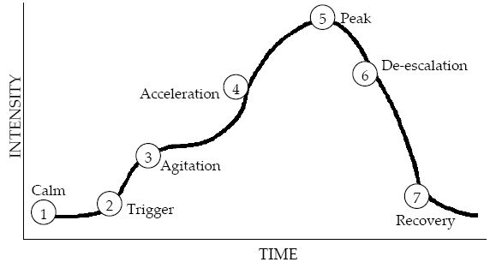
The Cycle
Matching Strategies to Phases in the Escalation Cycle

Slide 5
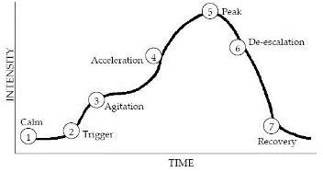
1. Calm Phase
.
The calm phase is characterized by appropriate, cooperative behavior and responsiveness to staff directions.
Maintain phase with teaching strategies, reinforcement, pacing. This can be described on a BIP as well and a longer calm phase.
Teach, pre correct, motivate, and build relationship to enhance self-regulation.

Slide 6
1. Calm Strategies
Teaching replacements behaviors and emotion regulation skills (relaxation, distraction, positive self-talk, mindfulness, and self-soothing).
Pre-correction (i.e., errorless learning) remind the student of potential triggers and the replacement behaviors and emotional regulation skills that can be used. Consider SUDS (subjective units of discomfort scaling) or “The incredible 5 point scale” to identify triggers.
Sampling the reinforcer: this involves energizing the student’s motivation to manage themselves in the face of triggers in order to gain later reinforcement. Sampling the reinforce has been shown to increase self-regulation and increase the probability the student will not become agitated in the face of the trigger(s).
Relationship strategies that either focus on establishing, maintaining, or restoring the relationship.
Know what situations the student does find stressful and use that information to assess when the student may be able to confront the trigger and when it may be unsuccessful or unsuccessful without supports.
Within the PROMPT STRATEGY, use PROXIMITY CONTROL—move around the room but be sure to spend a few seconds in a friendly manner near the student.

Slide 7
2. Trigger Phase
Triggers (antecedents)= situations, people, interactions, directives, requests that provoke the agitation and potentially lead to more explosive behavior.
Pathway charting helps visualize paths and strategies to use and identify replacement behaviors to teach in the previous phase which can then be cued for use as the student faces the trigger in this phase.

Slide 8
Insert a blank pathway chart here

Slide 9
2. Trigger Strategies
Remove or reduce contact with triggers.
Use Time Away strategy (see: www.pent.ca.gov) or other self-selected removals to access time to self-soothe or avoid contact with the trigger.
Gesture/Verbal prompt a replacement behavior previously taught, modeled, and rehearsed during the calm stage.
Reinforce the student for exhibiting the replacement behaviors.
Within the PROMPT STRATEGY, use REDIRECTIION and ON GOING MONITORING.

Slide 10
3. Agitation Phase
The agitation stage is when the trigger has provoked an emotional reaction and the previous strategies are insufficient to avoid potential further escalation. The aim here is not to set firm limits and enforce them as the explosive student will likely escalate to a point that is highly disruptive, dangerous, and/or destructive.
The aim is to work with the student to prevent movement up the scale of escalation.

Slide 11
3. Agitation Strategies
Collaborative Problem-Solving (CPS) is the methodology to effectively communicate with an agitated explosive student to generate mutually agreed upon solutions so the student does not feel the need to escalate.
CPS involves three sequential steps:
Empathy statement (validation, acceptance, and understanding of the students feeling, motive, or reason),
sharing the adult perspective, and
negotiating or collaborating with the student to generate and enact a solution the student finds acceptable.
In the P.R.O.M.P.T. strategy, use a PROMPT not to sustain contact with the trigger, but rather a prompt to use the solution the student finds acceptable that you have predetermined for this student in this situation or you are determining now.

Slide 12
4. Acceleration Phase
Students in this phase continue to escalate their behavior and are unwilling to communicate with the adult who is using Collaborative Problem-solving. They question, argue, and engage in confrontational interactions; they are defiant of teacher communication, may swear, call staff names.
The aim here is to set-up places where the student can go in order to engage in a preferred activity and potentially use emotion regulation strategies.
In the P.R.O.M.P.T. strategy, this is Redirection.

Slide 13
4. Acceleration Strategies
Use non-verbal empathy messages.
Do not engage in reasoning, cajoling or other interactions that will further escalate, including frowning, crossing arms, looking mean.
Wait. Step away.
Do not put fuel on the fire by explaining, demanding, warning and other corrective procedures.
Consider gesturing toward a personalized spot in the room the student feels allows him to calm down in an inviting, non demanding manner.

Slide 14
5. Peak Phase
The student has reached full escalation and there is potential for highly disruptive, dangerous, or destructive behavior if the situation is not handled appropriately. It is imperative that staff have a protocol in place.

Slide 15
5. Peak Strategies
Adults regulate their own behavior by using calm voice tone, decreasing the amount of words spoken, leaving spaces between words, and decreased voice volume. Making sure the student does not feel like he is being overwhelmed by the adults and forced to do something. Focus on controlling staff behavior, demonstrating compassion and tolerance to the student.
When necessary intrusive short-term interventions, such as removing either the student who is acting out or the other students from the classroom; crisis intervention and prevention techniques (CPI. PROACT, etc.), calling the student’s parents, contacting the police, etc. may occur.
Remember that restraint can only be used when there is imminent danger to the student or others. It must generate a Incident Report.

Slide 16
6. De-escalation Phase
Once the behavior has left the Peak stage and calm is gradually returning to the student, use of techniques to restore relationships and assure the student that escalation is nearing an end can be used.

Slide 17
6. De-escalation Strategies
In general, do not add too much conversation yet.
“Pretty soon you will be calm again and we can fix the problem, Jared. Can I get you a drink of water?”
“Would you like to cool down further in our Coping Corner for a few minutes, etc.”
“I am impressed by the fact that you are calming much faster than you have before. I think you are moving toward success with your emotions.”

Slide 18
7. Recovery Phase
At this stage, the student is often more compliant that in the initial calm stage.
Here is where restoring relationship is critical.

Slide 19
7. Recovery Strategies
Rational problem solving dialogues can be helpful for both staff and student to understand why the explosion continued.
Forms such as “Thinking About My Inappropriate Behavior” (www.pent.ca.gov) can be used to debrief and restore relationship prior to reentry into tasks and performance requirements.

Slide 20
Thank You!
For all you do to work with students whose behaviors are challenging to adults, peers, and even the students themselves.
Diana Browning Wright
www.pent.ca.gov
dbrowningw@gmail.com
(626) 487-9455

